Slide 1
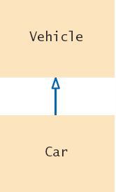
Inheritance Hierarchies
In object-oriented programming, inheritance is a relationship between:
The subclass ‘inherits’ data (variables) and behavior (methods) from the superclass
A superclass: a more generalized class
A subclass: a more specialized class

Slide 2
A Vehicle Class Hierarchy
General
Specialized
More Specific

Slide 3

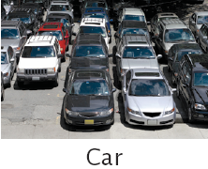
The Substitution Principle
Since the subclass Car “is-a” Vehicle
Car shares common traits with Vehicle
You can substitute a Car object in an algorithm that expects a Vehicle object
is-a
Car myCar = new Car(. . .);
processVehicle(myCar);
The ‘is-a’ relationship is represented by an arrow in a class diagram and means that the subclass can behave as an object of the superclass.

Slide 4
Identify Inheritance Relationships
Inheritance describes an “IS A” relationship
A car is a vehicle
A bus is a vehicle
A car is a bus (Not inheritance relationship)
An employee is a person
A customer is a person
A checking account is a kind of bank account
A savings account is a type of bank account
A Bentley is a car which is a vehicle

Slide 5
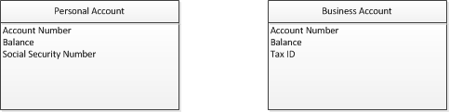
Bank Account Example
Assume in an application you need to define two types of Bank Accounts: Business Account and Personal Account
The two types of accounts share some common attributes: Account Number and Balance
But they differ in some others which are specific to each type of account

Slide 6
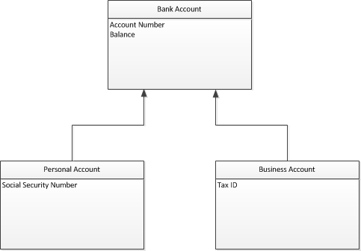
Bank Account Example
Using inheritance, you can define a Bank Account class that contain the general attributes that exist in both type of accounts (Account Number and Balance)
Personal Account and Business Account inherit from Bank Account
Each subclass defines the specific attributes that are applicable to themselves.

Slide 7
Advantages of Inheritance
Inheritance is a form of abstraction.
It is used to save duplication of information in different classes.
Inheritance is used to define a new class based on another class.
It is also a form of code reuse because you don’t have to define classes from scratch. You can base it on an existing class.

Slide 8
Inheritance Example
Think of how you can apply the inheritance principle to the classes below:
Person
Customer
Employee
name
phoneNumber
email
name
phoneNumber
email
customerNumber
name
phoneNumber
email
salary
changeNumber()
changeEmail()
changeNumber()
changeEmail()
changeNumber()
changeEmail()
raiseSalary()

Slide 9
Inheritance Example
Person class contains the general attributes and behaviors that is shared among all three classes. Customer is a type of Person; therefore, it can inherit the person attributes and behavior. The same is true for Employee.
Person
name
phoneNumber
email
Superclass
(Parent class)
changeNumber()
changeEmail()
Customer
Employee
Subclass
(Child class)
customerNumber
salary
raiseSalary()
Customer inherits from Person or Customer is derived from Person
Employee inherits from Person
Employee is derived from Person

Slide 10
Inheritance
A subclass is created using the keyword extends as in: Note : Subclasses should in some way modify the behavior of the class they are extending using additional variables and methods
class Customer extends Person
{ }
Page 10

Slide 11

Programming Tip
Use a Single Class for Variation in Values, Inheritance for Variation in Behavior
If two vehicles only vary by fuel efficiency, use an instance variable for the variation, not inheritance
If two vehicles behave differently,
use inheritance
// Car instance variable
double milesPerGallon;
Be careful not to over-use inheritance

Slide 12
Inheriting from the Superclass
Subclasses inherit from the superclass:
All public methods that it does not override
All instance variables
The Subclass can
Add new instance variables
Add new methods
Change the implementation of inherited methods
Form a subclass by specifying what is different from the superclass.

Slide 13
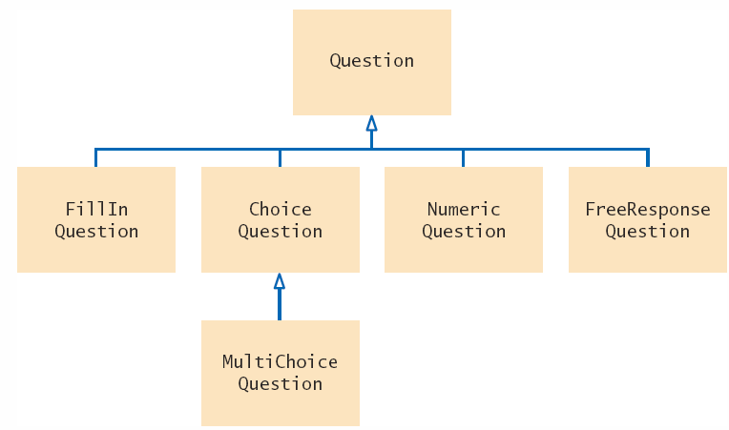
Quiz Question Hierarchy
There are different types of quiz questions:
1) Fill-in-the-blank
2) Single answer choice
3) Multiple answer choice
4) Numeric answer
5) Free Response
A question can:
Display it’s text
Check for correct answer
The ‘root’ of the hierarchy is shown at the top.

Slide 14
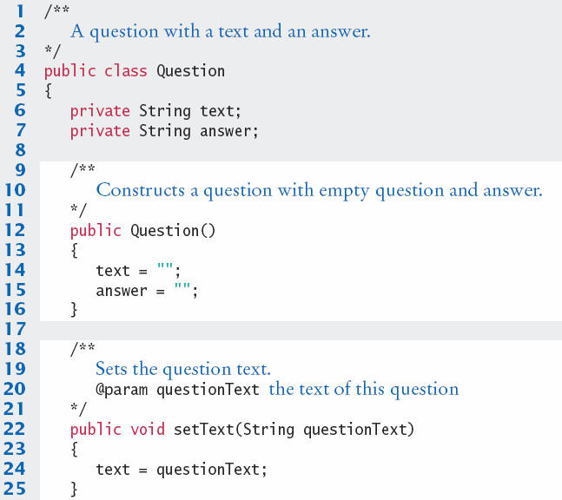
Question.java (1)
The class Question is the ‘root’ of the hierarchy, also known as the superclass
Only handles Strings
No support for:
Approximate values
Multiple answer choice

Slide 15
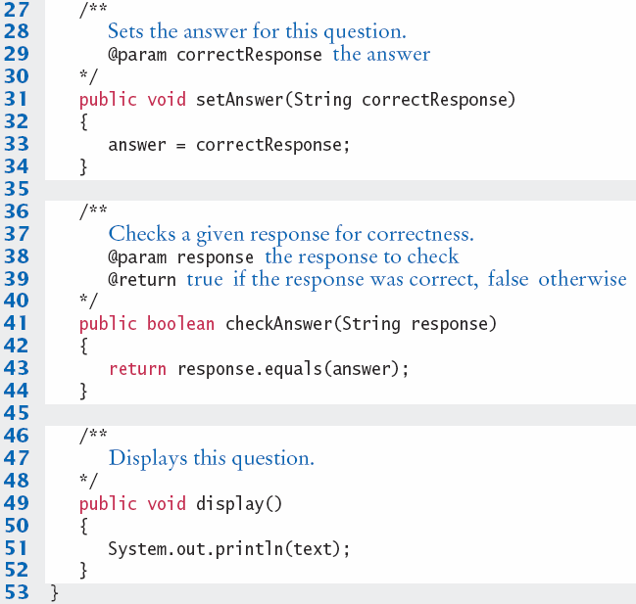
Question.java (2)

Slide 16
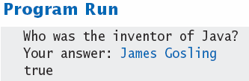
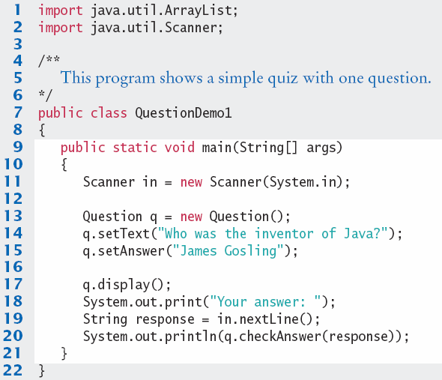
QuestionDemo1.java
Creates an object of the Question class and uses methods.

Slide 17
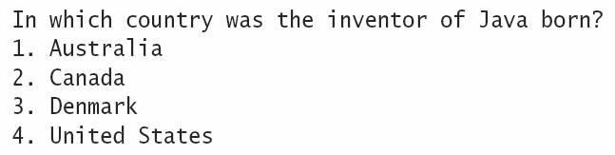
Implementing Subclasses
Consider implementing ChoiceQuestion to handle:
How does ChoiceQuestion differ from Question?
It stores choices (1,2,3 and 4) in addition to the question
There must be a method for adding multiple choices
The display method will show these choices below the question, numbered appropriately
In this section you will see how to form a subclass and how a subclass automatically inherits from its superclass

Slide 18
Overriding Superclass Methods
Can you re-use any methods of the Question class?
Inherited methods perform exactly the same
If you need to change how a method works:
Write a new more specialized method in the subclass
Use the same method name as the superclass method you want to replace
It must take all of the same parameters
This will override the superclass method
The new method will be invoked with the same method name when it is called on a subclass object
A subclass can override a method of the superclass by providing a new implementation.

Slide 19
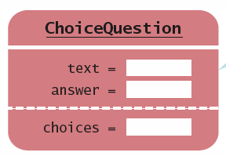
Planning the subclass
Use the reserved word extends to inherit from Question
Inherits text and answer variables
Add new instance variable choices
public class ChoiceQuestion extends Question
{
// This instance variable is added to the subclass
private ArrayList<String> choices;
// This method is added to the subclass
public void addChoice(String choice, boolean correct) { . . . }
// This method overrides a method from the superclass
public void display() { . . . }
}

Slide 20
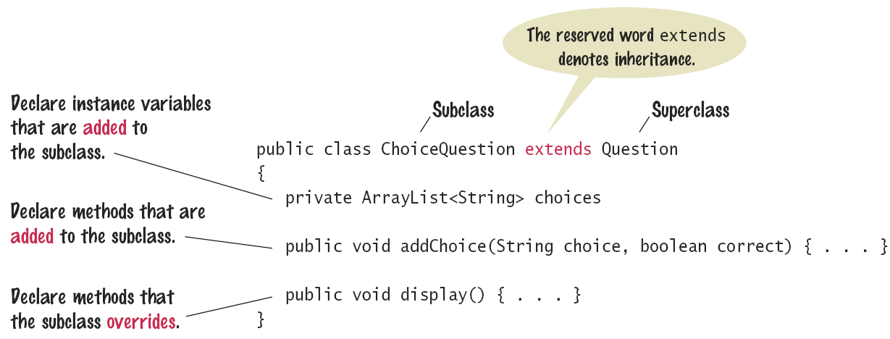
Syntax : Subclass Declaration
The subclass inherits from the superclass and ‘extends’ the functionality of the superclass

Slide 21
Implementing addChoice
The method will receive two parameters
The text for the choice
A boolean denoting if it is the correct choice or not
It adds text as a choice, adds choice number to the text and calls the inherited setAnswer method
public void addChoice(String choice, boolean correct)
{
choices.add(choice);
if (correct)
{
// Convert choices.size() to string
String choiceString = "" + choices.size();
setAnswer(choiceString);
}
}
setAnswer() is the same as calling this.setAnswer()

Slide 22
Common Error
Replicating Instance Variables from the Superclass
A subclass cannot directly access private instance variables of the superclass
public class Question
{
private String text;
private String answer;
. . .
public class ChoiceQuestion extends Question
{
. . .
text = questionText; // Complier Error!

Slide 23
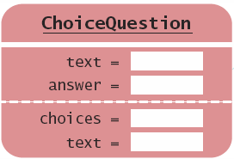
Common Error
Do not try to fix the compiler error with a new instance variable of the same name
The constructor sets one text variable
The display method outputs the other
public class ChoiceQuestion extends Question
{
private String text; // Second copy

Slide 24
Common Error
Confusing Super- and Subclasses
The use of the terminology super and sub may be confusing
The Subclass ChoiceQuestion is an ‘extended’ and more powerful version of Question
Is it a ‘super’ version of Question?... NO.
Super and Subclass terminology comes from set theory
ChoiceQuestion is one of a subset of all objects that inherit from Question
The set of Question objects is a superset of ChoiceQuestion objects

Slide 25
Overriding Methods
The ChoiceQuestion class needs a display method that overrides the display method of the Question class
They are two different method implementations
The two methods named display are:
Question display
Displays the instance variable text String
ChoiceQuestion display
Overrides Question display method
Displays the instance variable text String
Displays the local list of choices

Slide 26
Calling Superclass Methods
Consider the display method of the ChoiceQuestion class
It needs to display the question AND the list of choices
text is a private instance variable of the superclass
How do you get access to it to print the question?
Call the display method of the superclass Question!
From a subclass,
preface the method
name with:
super.
public void display()
{
// Display the question text
super.display(); // OK
// Display the answer choices
. . .
}

Slide 27
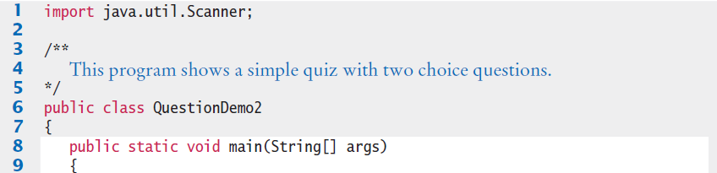
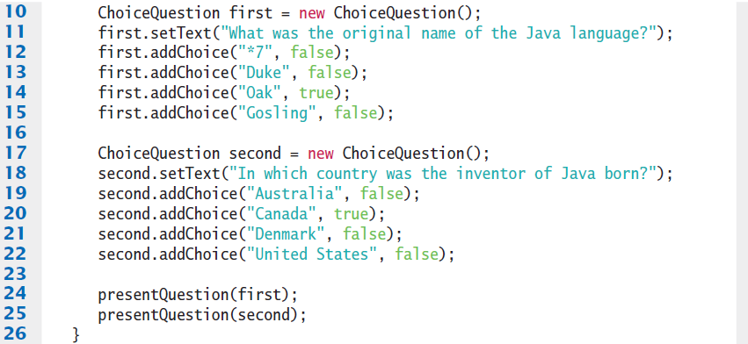
QuestionDemo2.java (1)
Creates two objects of the ChoiceQuestion class, uses new addChoice method.
Calls presentQuestion (next page)

Slide 28
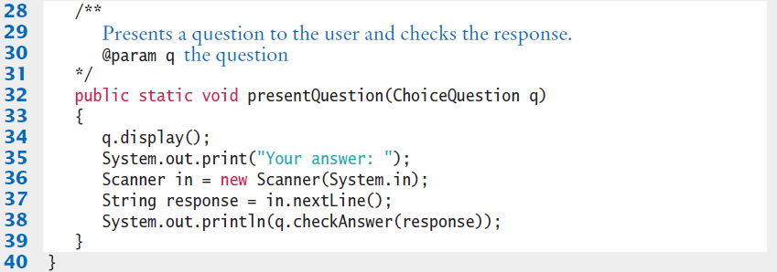
QuestionDemo2.java (2)
Uses ChoiceQuestion (subclass) display method.

Slide 29
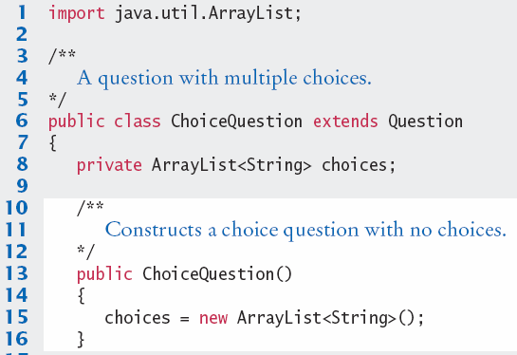
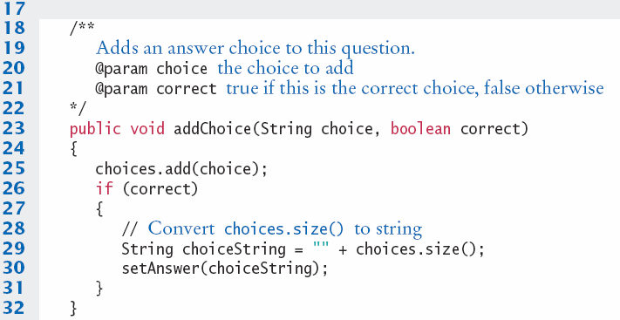
ChoiceQuestion.java (1)
Inherits from Question class.
New addChoice method.

Slide 30
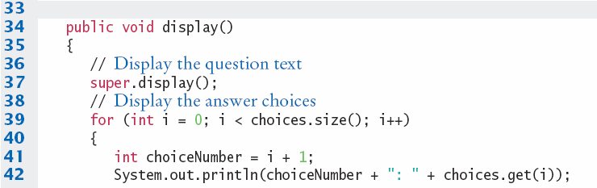

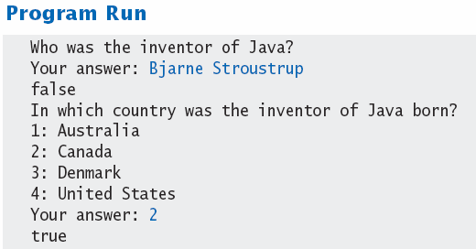
ChoiceQuestion.java (2)
Overridden display method.

Slide 31
Common Error
Accidental Overloading
Remember that overloading is when two methods share the same name but have different parameters
Overriding is where a subclass defines a method with the same name and exactly the same parameters as the superclass method
Question display() method
ChoiceQuestion display() method
If you intend to override, but change parameters, you will be overloading the inherited method, not overriding it
ChoiceQuestion display(printStream out) method
println(int x);
println(String s); // Overloaded

Slide 32
Common Error
Forgetting to use super when invoking a Superclass method
Assume that Manager inherits from Employee
getSalary is an overridden method of Employee
Manager.getSalary includes an additional bonus
public class Manager extends Employee
{
. . .
public double getSalary()
{
double baseSalary = getSalary(); // Manager.getSalary
// should be super.getSalary(); // Employee.getSalary
return baseSalary + bonus;
}
}

Slide 33

ChoiceQuestion Demo Constructor
Calling the Superclass Constructor
When a subclass is instantiated, it will call the superclass constructor with no arguments
If you prefer to call a more specific constructor, you can invoke it by using replacing the superclass name with the reserved word super followed by ():
It must be the first statement in your constructor
public ChoiceQuestion(String questionText)
{
super(questionText);
choices = new ArrayList<String>();
}

Slide 34
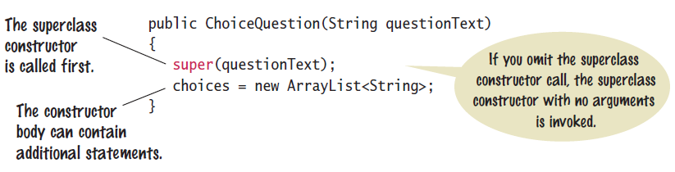
Constructor with Superclass
To initialize private instance variables in the superclass, invoke a specific constructor

Slide 35
Special
Final Methods and Classes
You can also prevent programmers from creating subclasses and override methods using final.
The String class in the Java library is an example:
Example of a method that cannot be overridden:
public final class String { . . . }
public class SecureAccount extends BankAccount
{
. . .
public final boolean checkPassword(String password)
{
. . .
}
}

Slide 36
Special Topic
protected Access
When trying to implement the display method of the ChoiceQuestion class, the display method wanted to access the instance variable text of the superclass, but it was private.
We chose to use a method of the superclass to display the text.
Java provides a more elegant solution
The superclass can declare an instance variable as protected instead of private
protected data in an object can be
accessed by the methods of the
object’s class and all its subclasses.
But it can also be accessed by all
other classes in the same package!
public class Question
{
protected String text;
. . .
}
If you want to grant access to the data to subclass methods only, consider making the accessor method protected.

Slide 37
Steps to Using Inheritance
As an example, we will consider a bank that offers customers the following account types:
1) A savings account that earns interest. The interest compounds monthly and is based on the minimum monthly balance.
2) A checking account that has no interest, gives you three free withdrawals per month, and charges a $1 transaction fee for each additional withdrawal.
The program will manage a set of accounts of both types
It should be structured so that other account types can be added without affecting the main processing loop.
The menu: D)eposit W)ithdraw M)onth end Q)uit
For deposits and withdrawals, query the account number and amount. Print the balance of the account after each transaction.
In the “Month end” command, accumulate interest or clear the transaction counter, depending on the type of the bank account. Then print the balance of all accounts.

Slide 38
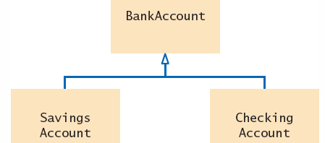
Steps to Using Inheritance
1) List the classes that are part of the hierarchy.
SavingsAccount
CheckingAccount
2) Organize the classes into an inheritance.
hierarchy
Base on superclass BankAccount
3) Determine the common responsibilities.
a. Write Pseudocode for each task
b. Find common tasks

Slide 39
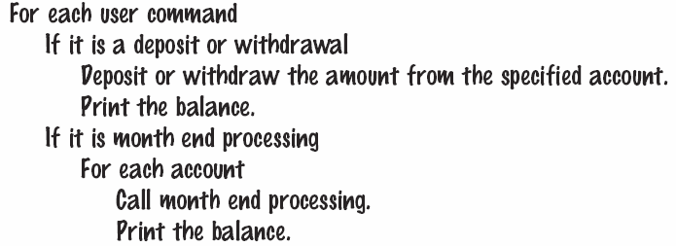
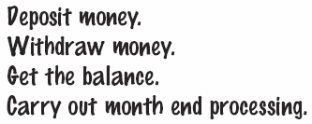
Using Inheritance

Slide 40
Steps to Using Inheritance
4) Decide which methods are overridden in subclasses.
For each subclass and each of the common responsibilities, decide whether the behavior can be inherited or whether it needs to be overridden
5) Declare the public interface of each subclass.
Typically, subclasses have responsibilities other than those of the superclass. List those, as well as the methods that need to be overridden.
You also need to specify how the objects of the subclasses should be constructed.
6) Identify instance variables.
List the instance variables for each class. Place instance variables that are common to all classes in the base of the hierarchy.
7) Implement constructors and methods.
8) Construct objects of different subclasses and process them.

Slide 41
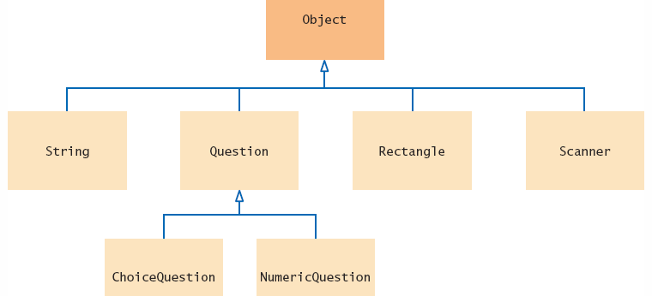
Object: The Cosmic Superclass
In Java, every class that is declared without an explicit extends clause automatically extends the class Object.
The methods of the Object class are very general. You will learn to override the toString method.

Slide 42
Writing a toString method
The toString method returns a String representation for each object.
The Rectangle class (java.awt) has a toString method
You can invoke the toString method directly
The toString method can also be invoked implicitly whenever you concatenate a String with an object:
The compiler can invoke the toString method, because it knows that every object has a toString method:
Every class extends the Object class, and can override toString
Rectangle box = new Rectangle(5, 10, 20, 30);
String s = box.toString(); // Call toString directly
// Sets s to "java.awt.Rectangle[x=5,y=10,width=20,height=30]“
System.out.println("box=" + box); // Call toString implicitly

Slide 43
Overriding the toString method
Example: Override the toString method for the BankAccount class
All that is printed is the name of the class, followed by the hash code which can be used to tell objects (Chapter 10)
We want to know what is inside the object
BankAccount momsSavings = new BankAccount(5000);
String s = momsSavings.toString();
// Sets s to something like "BankAccount@d24606bf"
public class BankAccount
{
public String toString()
{
// returns "BankAccount[balance=5000]"
return "BankAccount[balance=" + balance + "]";
}
}
Override the toString method to yield a string that describes the object’s state.

Slide 44
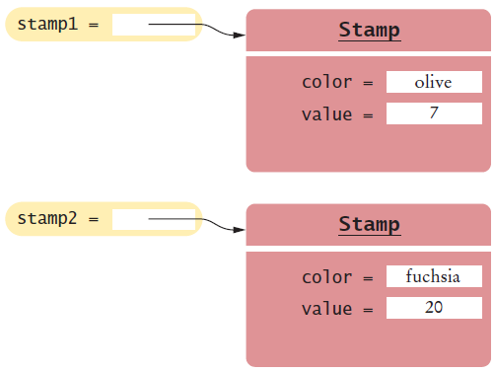
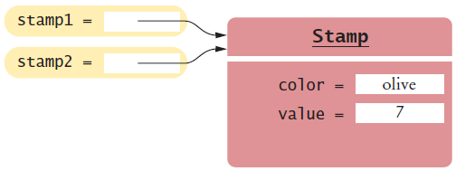
Overriding the equals method
In addition to the toString method, the Object class equals method checks whether two objects have the same contents:
This is different from the == operator which compares the two references:
if (stamp1.equals(stamp2)) . . . // same Contents?
if (stamp1 == stamp2) . . . // same Objects?

Slide 45
Overriding the equals method
The Object class specifies the type of parameter as Object
public class Stamp
{
private String color;
private int value;
. . .
public boolean equals(Object otherObject)
{
. . .
}
. . .
}
The Stamp equals method must declare the same type of parameter as the Object equals method to override it.
public boolean equals(Object otherObject)
{
Stamp other = (Stamp) otherObject;
return color.equals(other.color)
&& value == other.value;
}
Cast the parameter variable to the class Stamp

Slide 46
Shadowing / Hiding
Shadowing or hiding can occur in one of the following cases:
A parameter name is the same as a class or instance variable. The parameter name hides the instance or class variable.
A class or instance variable in the subclass has the same name as the class or instance variable in the super class.
A class method in the subclass has the same signature as a class method in the super class. (Overriding occurs only for instance methods).

Slide 47
Shadowing / Hiding
In this example, try to figure out the output of the assign method:
class SuperClass {
int j = 1;
}
class Derived extends SuperClass {
int j = 2;
void assign(int j) {
System.out.println(j);
System.out.println(super.j);
System.out.println(this.j);
}
}
class SuperThis {
static public void main (String [] args) {
Derived d1 = new Derived ();
d1.assign(4);
}
}

Slide 48
Shadowing / Hiding
class SuperClass {
int j = 1;
}
class Derived extends SuperClass {
int j = 2;
void assign(int j) {
System.out.println(j);
System.out.println(super.j);
System.out.println(this.j);
}
}
j is the parameter which is 4
super.j is the SuperClass instance variable which is 1
this.j is the Drived class instance variable which is 2

